Slide 1

Fake product identification using blockchain
1602-20-737-145(S. Manmateja
1602-20-737-156(A. Ruthwik)
Guide: dr. k. Rama krishna

Slide 2
Problem Statement:
In the face of rising counterfeit challenges globally, especially in countries like India, the proposed system employs blockchain technology to generate secure QR codes. These QR codes, storing transaction records in tamper-resistant blocks, facilitate quick and accurate identification of counterfeit products. This integrated solution ensures product authenticity, protecting both company reputation and consumer safety in the ongoing battle against fake products.

Slide 3
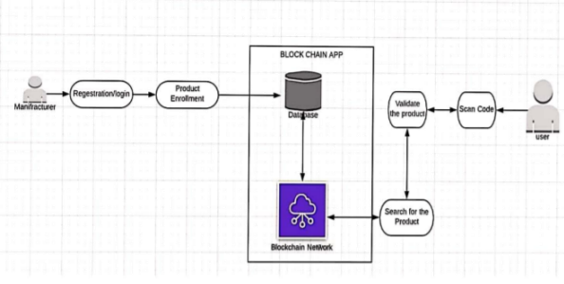
Proposed model:

Slide 4
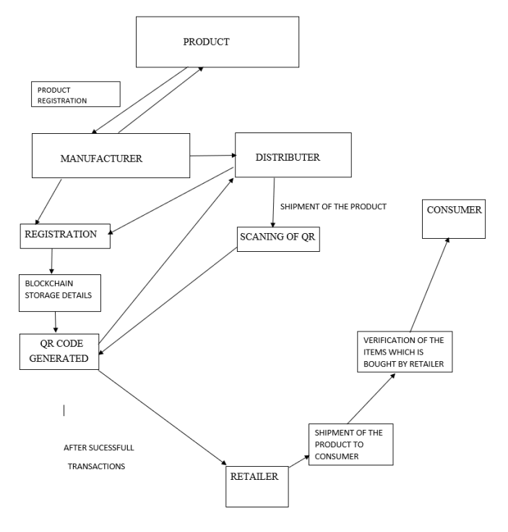
Architecture:

Slide 5
Technologies used:
Ganache
Truffle
Solidity
smart contract:
->Upon composing a smart contract using Solidity code.
->Establish a connection with Ganache through a .json file that specifies the local host.
->This .json file ensures that the contract seamlessly interfaces with Ganache when executing Truffle commands.

Slide 6
Assign Ether values(Token) to voters:
After smart contract validation, token are assigned to each product to store details.
It helps to maintain securing orginal product details.
Assigning of token will be validated by using MetaMask connection where it has private key different for each voter.

Slide 7
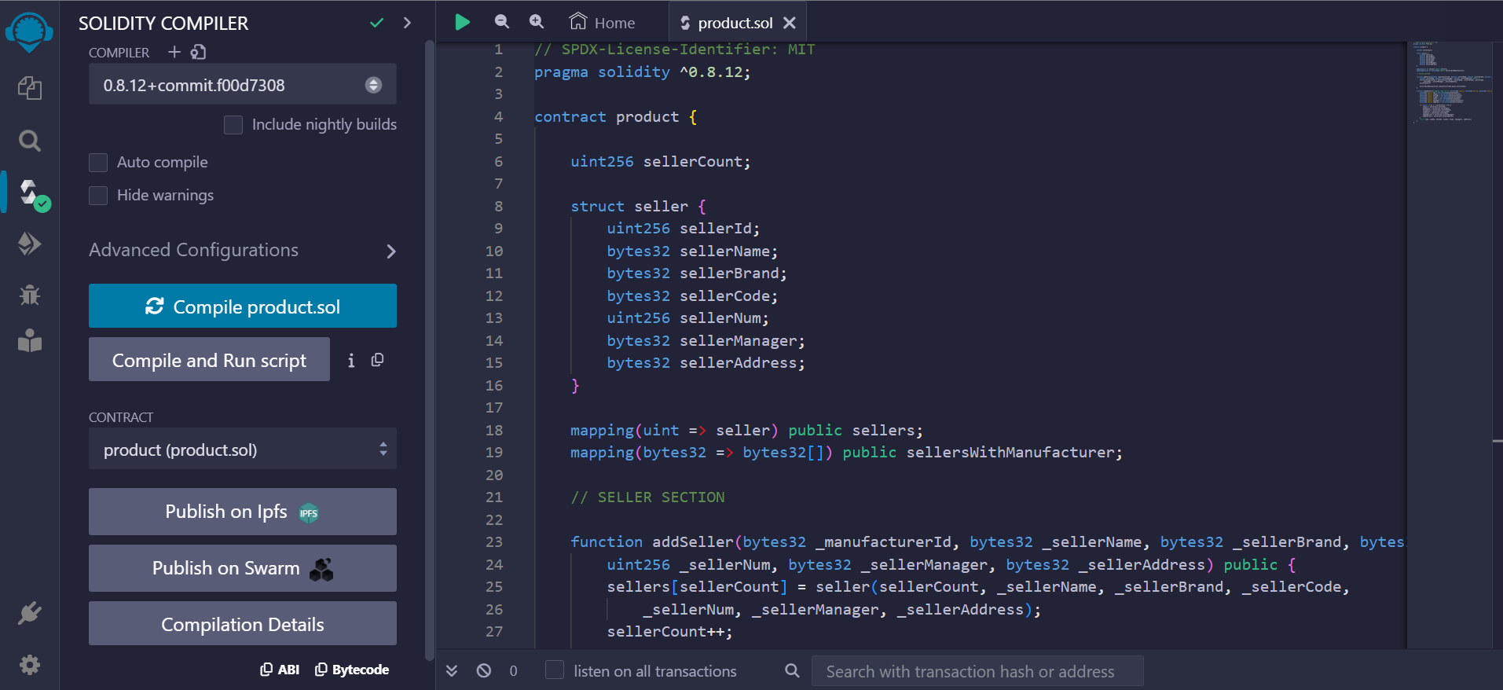
Outputs:

Slide 8
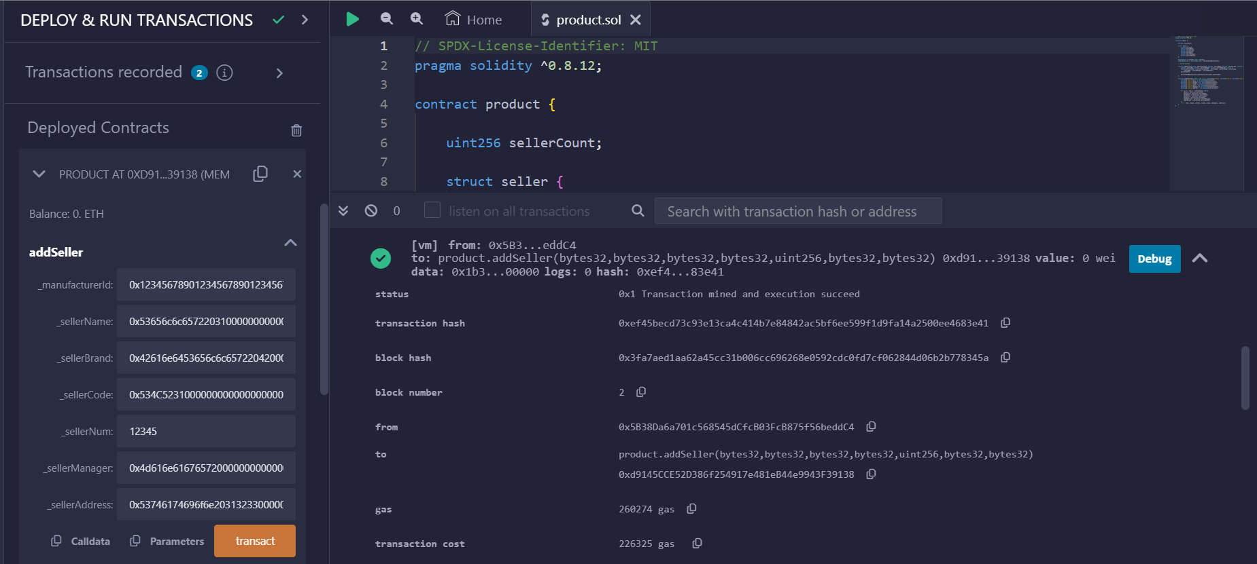

Slide 9
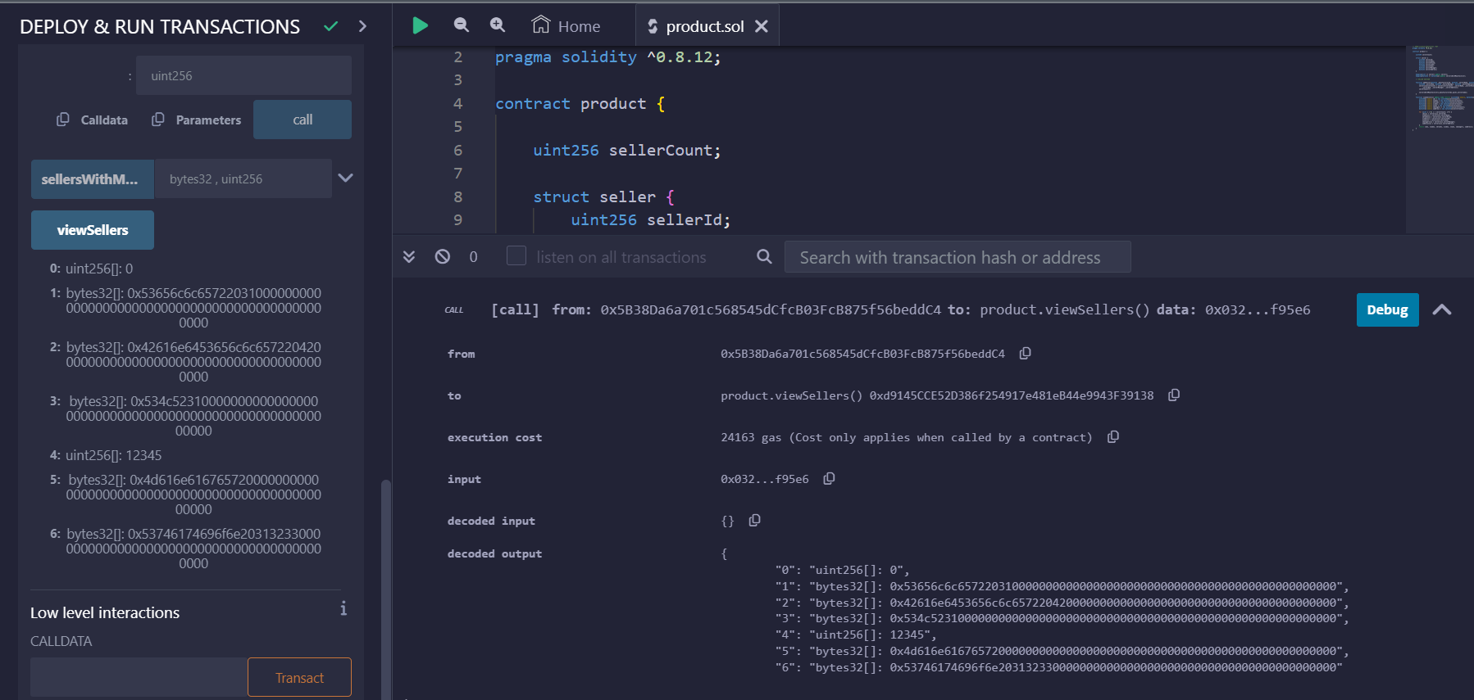

Slide 10
Next Review:
Implement all smart contract functions.
Implementing front-end.

Slide 11

Thank You!
someone@example.com

